Slide 1
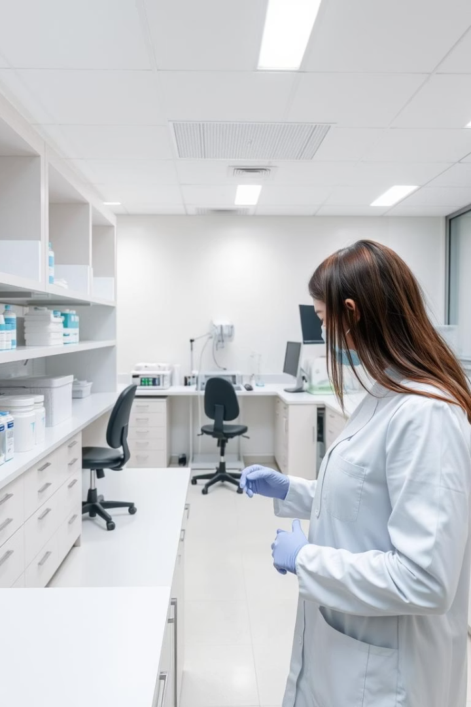
AIE424 : Intelligent Decision Support Systems
Personalized Antibiogram Optimization Using Linear Programming
This presentation introduces a linear programming framework designed to optimize antibiotic selection by integrating personalized antibiogram predictions. The system aims to maximize treatment efficacy while respecting clinical prescribing constraints, supporting antimicrobial stewardship goals. Simulations of 1,000 infections demonstrate improved coverage compared to clinician and random strategies. Budget-sweep analyses reveal thresholds for substituting broad-spectrum antibiotics with narrower alternatives, highlighting the potential to reduce resistance pressure in clinical practice.
Aly Maher Abdelfattah Abdelrahman (221101789) Sohila Ahmed Zakria (221101149) Abdelrahman Mohamed Mahmoud (221101107)

Slide 2

Introduction to Antimicrobial Resistance and Optimization
AMR Challenge
Optimization Goals
Antimicrobial resistance is a growing public health concern, worsened by overuse of broad-spectrum antibiotics in empiric therapy.
The framework maximizes treatment efficacy, minimizes broad-spectrum antibiotic use, and supports substitution with narrower agents under clinical constraints.
Simulation Approach
1,000 synthetic infections were simulated to compare random, clinician-guided, and optimized antibiotic allocations.

Slide 3
Methodology and Data Description
Data Description
Linear Programming Model
Simulated dataset of 1,000 infections with true susceptibility and clinician and random antibiotic assignments across four drugs.
Decision matrix assigns one antibiotic per infection, maximizing predicted susceptibility while respecting usage budgets.
Binary susceptibility indicators for Pip-Tazo, Cefepime, Ceftriaxone, Cefazolin
Single antibiotic per infection constraint
Antibiotic usage budgets based on clinician patterns
Personalized antibiogram prediction probabilities with AUROC of 0.65

Slide 4
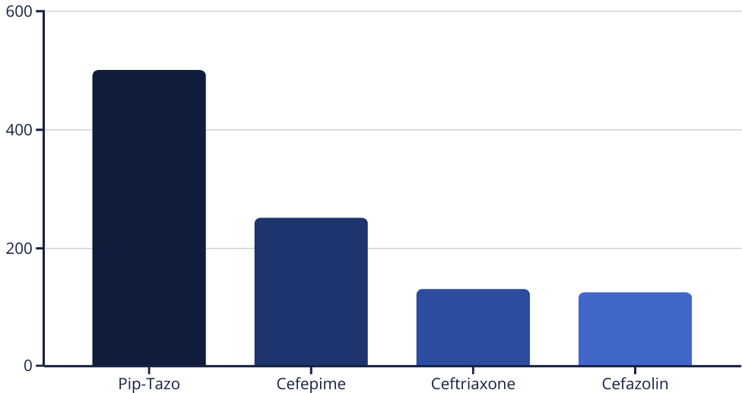
Sample Data Snapshot
INFECTION_ID
Random_ABX_RX
Pip_Tazo
Cefepime
Ceftriaxone
Cefazolin
Pip_Tazo_predictions
Cefepime_predictions
Ceftriaxone_predictions
Cefazolin_predictions
ABX_RX
0
Pip_Tazo
1
1
1
1
0.571996
0.706604
0.648257
0.533554
Pip_Tazo
2
Pip_Tazo
1
1
0
1
0.760161
0.854547
0.172386
0.831246
Cefepime

Slide 5
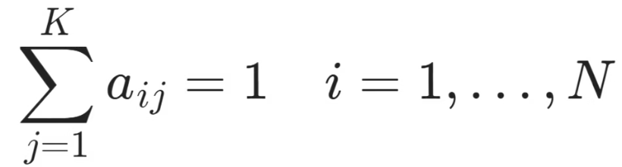
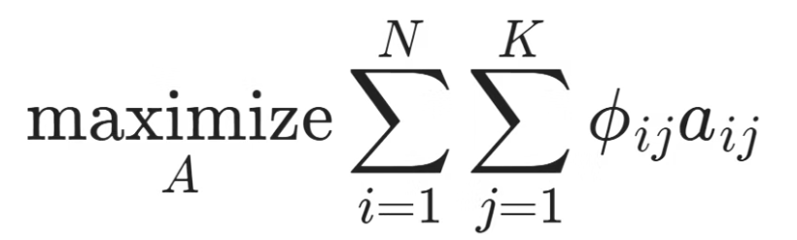
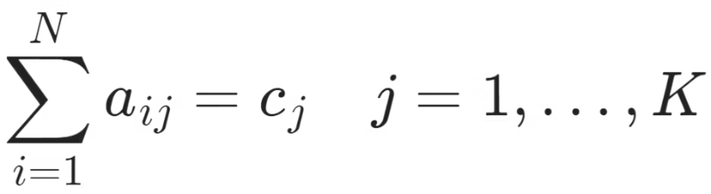
Methodology: Linear Programming (LP)
Goal
Constraints
Maximize total coverage across all infections and antibiotics.
Each infection must receive 1 antibiotic:
Objective Function:
Antibiotic usage matches real-world totals:

Slide 6
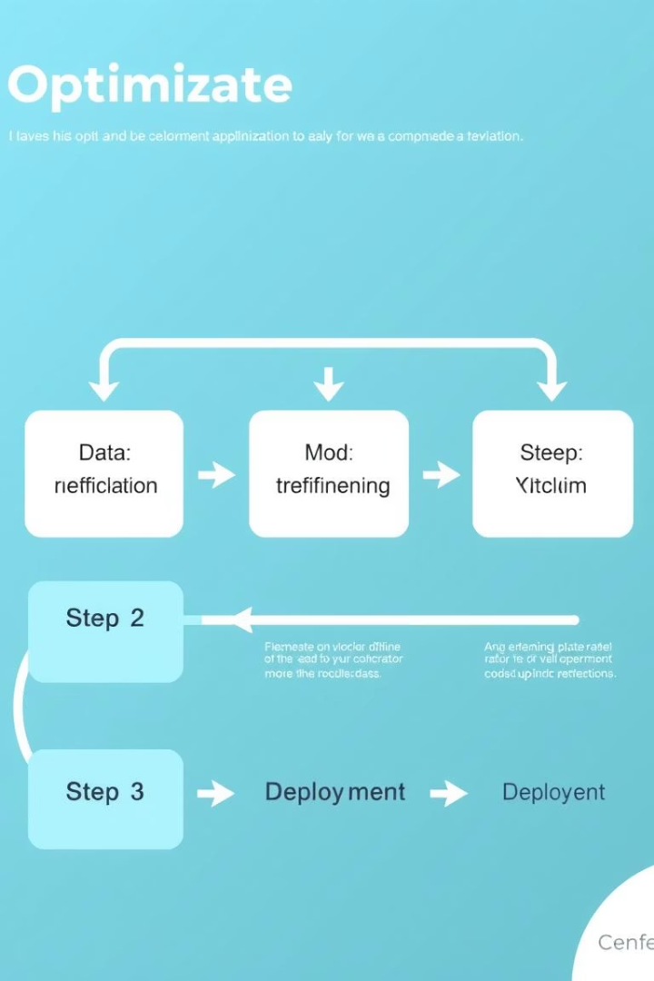
Optimization Workflow and Evaluation Metrics
1
Baseline Solve
2
Budget Sweep
Optimize coverage using clinician-derived antibiotic budgets.
Incrementally substitute Piperacillin–Tazobactam with narrower-spectrum antibiotics and track coverage.
3
Evaluation Metrics
Coverage rate, AUROC for model discrimination, and average precision for probability reliability.

Slide 7
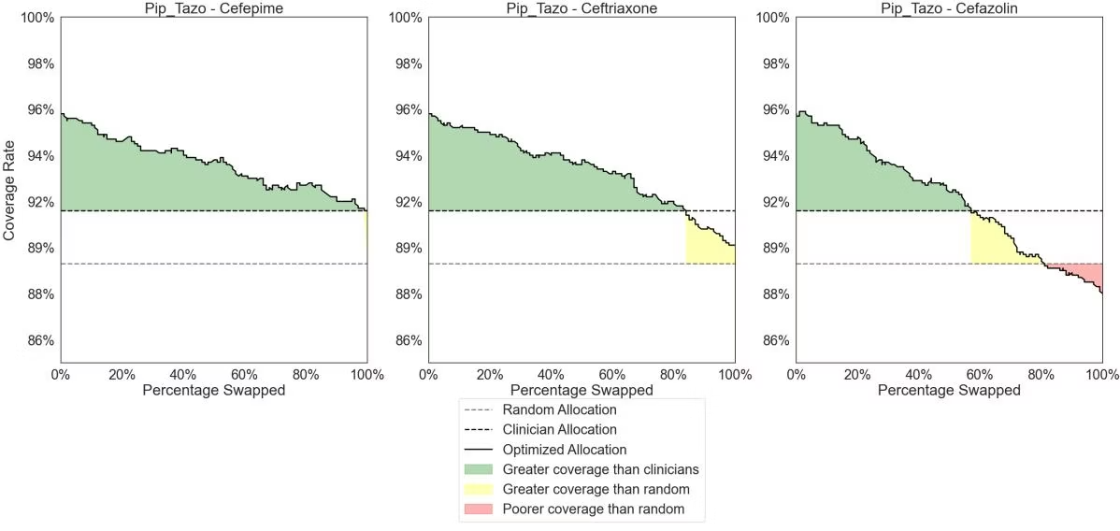
Results: Model Performance and Coverage Rates
Model Performance
Coverage Rates
AUROC ~0.65 across all four antibiotics
Random allocation: 89.3%
High average precision indicating reliable predictions
Clinician allocation: 91.6%
Optimized allocation: 95.8%

Slide 8
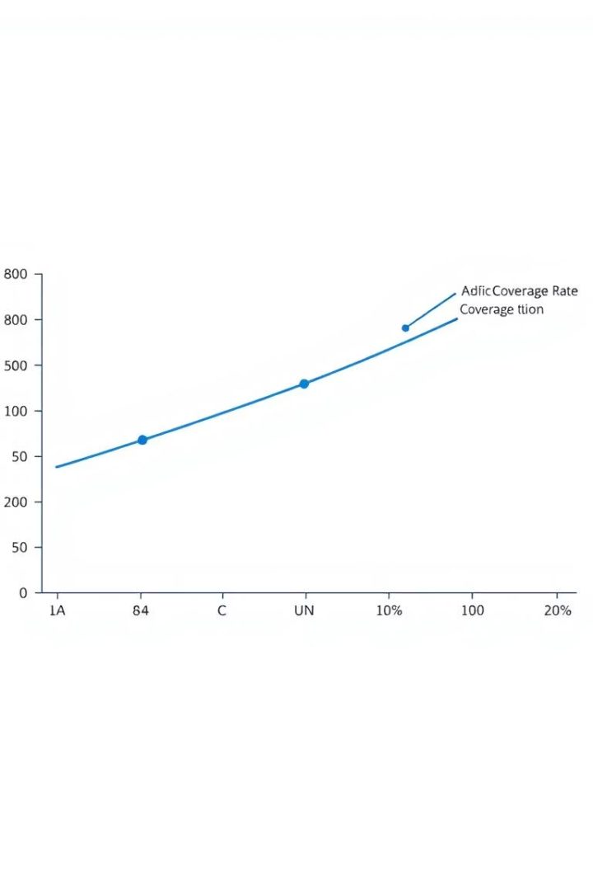
Budget Sweep Analysis: Substitution Thresholds
Pip-Tazo → Cefepime
Pip-Tazo → Ceftriaxone
Coverage stays above clinician benchmark up to 30% substitution and above 90% until 40%.
Coverage drops below clinician level at 20% substitution, limiting substitution potential.
Pip-Tazo → Cefazolin
Coverage falls below random allocation at 15% substitution, indicating early performance loss.

Slide 9
Discussion: Insights, Implications, and Limitations
Key Insights
Clinical Implications
LP optimization outperforms clinician and random prescribing by prioritizing high-likelihood treatments and reducing broad-spectrum use.
Supports targeted de-escalation policies for stewardship programs
Potential integration with EHRs for real-time prescribing guidance
Substitution thresholds vary by antibiotic, with Cefepime allowing more flexibility.
Limitations include synthetic data, omission of cost/resistance metrics, and single-drug assignment constraint.

Slide 10
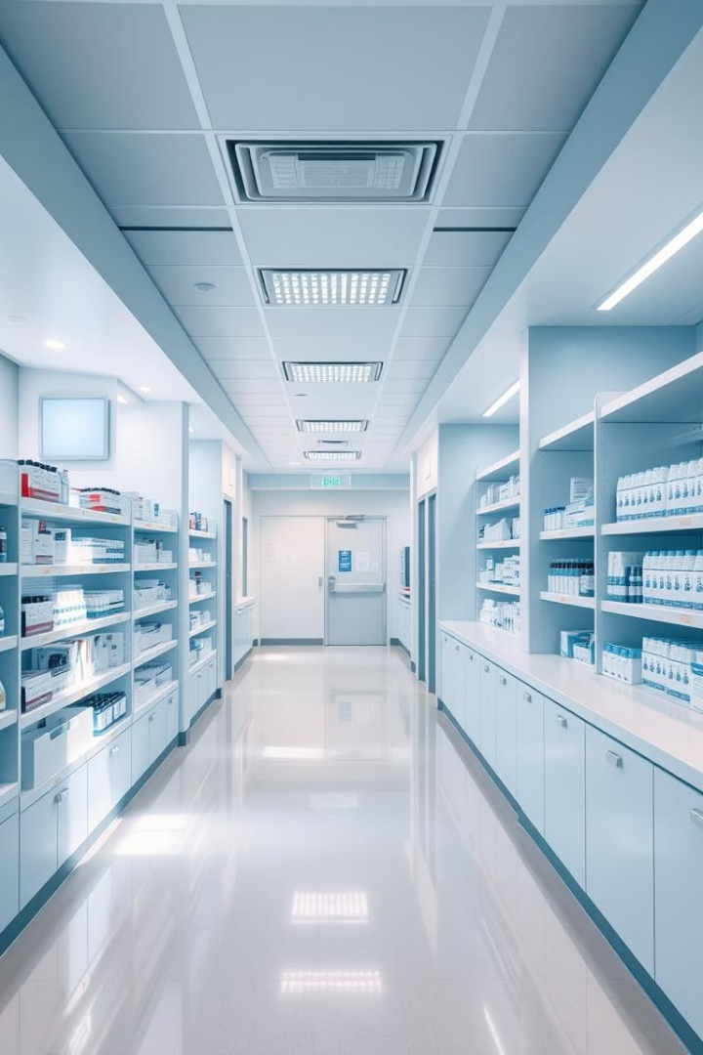
Conclusion and Future Directions
Quantifiable Benefit
4.2% absolute coverage improvement over standard prescribing with LP optimization.
Stewardship Guidance
Defined substitution limits enable safer de-escalation of broad-spectrum antibiotics.
Future Work
Incorporate real-world data, multi-objective optimization, and adaptive budgeting for dynamic stewardship.

Slide 11

🙏 Thank You for Your Attention
We appreciate your time and interest in our work.
Let's work together towards more precise, responsible antibiotic use.
Engagement
Innovation
Impact
Collaborate with clinical teams to improve antibiotic stewardship.
Leverage data-driven models for personalized therapy decisions.
Enhance patient outcomes while minimizing resistance risks.

